Slide 1
Take a Ride on the Bus
Practical Messaging and Queueing
Chris Meadows
Director of Software Engineering
& Senior Developer
Cloudswell
Email: meadoch1@gmail.com
Twitter: @meadoch1

Slide 2
Agenda
What’s messaging?
Why would I want to use it?
Examples
Q&A

Slide 3
Setting the Stage
Enterprise Patterns
Scope
Intro to using messaging
Academic background (but not a lot)
Pointers to tools
Provide actionable info to use when you get back to work
ESB
Frameworks in depth

Slide 4
Fact or Fiction?
Use of messaging can make your applications easier to
build,
understand,
and maintain
Notes:
Need to add Peter’s updated info

Slide 5
What is Messaging?
“Message passing in computer science is a form of communication used in parallel computing, object-oriented programming, and interprocess communication. In this model, processes or objects can send and receive messages (comprising zero or more bytes, complex data structures, or even segments of code) to other processes. By waiting for messages, processes can also synchronize.” - from Wikipedia

Slide 6
What is Messaging? (Practically Speaking)
A means of communication between two distinct programmatic constructs
Could be
inter-process
between simple objects
asynchronous

Slide 7
Sound Familiar?
CORBA
.NET Remoting
Java RMI
DCOM
AMQP
Erlang inter-process calls
Web Services
Ruby method calls
SOAP
Smalltalk method calls
RESTful APIs

Slide 8
What is a message?
A defined series of bytes which can be encoded and decoded with consistent meaning

Slide 9
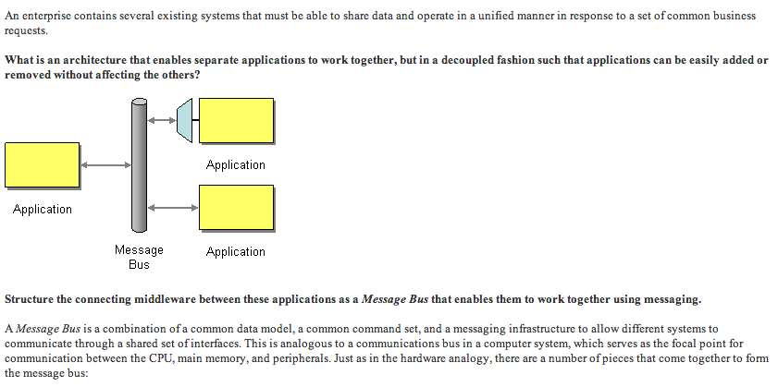
What is a message bus?
from http://www.eaipatterns.com/MessageBus.html

Slide 10

Warning…
http://commons.wikimedia.org/wiki/File:Amargosa_desert.jpg

Slide 11
What is a message bus?
Characteristics
Anatomy
Patterns

Slide 12
Characteristics
What is a message bus?

Slide 13
Characteristics of a Message Bus
Reliable Transfer
Preservation of Order
Broadcast/Collection
Synchronous/Async
Notes:
Concerns for message passing system
Reliable transfer
Not always a requirement
ie Twitter
Preserve order
One-one, one-many, many-one, many-many
synchronous or async
Sync
RPC
Method invocation in OOP
Async
Pub-sub
Twitter
Facebook
parallel processing

Slide 14
Characteristics of a Message Bus Reliable Transfer
Do you need guarantees of delivery?
Maybe Yes
Request processing
System state change
…
Maybe No
Status update
“Tweets”
Heartbeats
Notes:
Concerns for message passing system
Reliable transfer
Not always a requirement
ie Twitter
Preserve order
One-one, one-many, many-one, many-many
synchronous or async
Sync
RPC
Method invocation in OOP
Async
Pub-sub
Twitter
Facebook
parallel processing

Slide 15
Characteristics of a Message Bus Preservation of Order
Do you need messages delivered in the same order as sent?
Maybe Yes
Status update
System state change
…
No
Voting
“Tweets”
Heartbeats
Notes:
Concerns for message passing system
Reliable transfer
Not always a requirement
ie Twitter
Preserve order
One-one, one-many, many-one, many-many
synchronous or async
Sync
RPC
Method invocation in OOP
Async
Pub-sub
Twitter
Facebook
parallel processing

Slide 16
Characteristics of a Message Bus Broadcast/Collection
How many senders are talking to how many recievers?
One – One
One – Many
Many – One
Many - Many
Notes:
Concerns for message passing system
Reliable transfer
Not always a requirement
ie Twitter
Preserve order
One-one, one-many, many-one, many-many
synchronous or async
Sync
RPC
Method invocation in OOP
Async
Pub-sub
Twitter
Facebook
parallel processing

Slide 17
Characteristics of a Message Bus Synchronous / Asynchronous
Do you need serial processing?
Synchronous
RPC
Method invocation in OOP
…
Asynchronous
Pub/Sub
Twitter
Facebook
Parallel Processing
Notes:
Concerns for message passing system
Reliable transfer
Not always a requirement
ie Twitter
Preserve order
One-one, one-many, many-one, many-many
synchronous or async
Sync
RPC
Method invocation in OOP
Async
Pub-sub
Twitter
Facebook
parallel processing

Slide 18
Anatomy
What is a message bus?

Slide 19
Anatomy of a Message Bus
Message Storage
Serialization Protocols
Transport Mechanism
Notes:
Flexible – pipelining, binary safe strings
Rearrange in tables

Slide 20
Anatomy of a Message Bus Message Storage
Frequently involves a Queue
Allows delayed processing
Can preserve order
Can offer fault tolerance
Notes:
Flexible – pipelining, binary safe strings
Rearrange in tables

Slide 21
Anatomy of a Message Bus Message Storage
Database Backed
File Backed
In Memory
Notes:
Flexible – pipelining, binary safe strings
Rearrange in tables

Slide 22
Anatomy of a Message Bus Message Storage
Database Backed
File Backed
In Memory
Pros
Simple to set up
Tools are usually at hand
Easy view into your queues
Cons
Prone to contention at high volumes
Dependency on additional tool
Notes:
Flexible – pipelining, binary safe strings
Rearrange in tables

Slide 23
Anatomy of a Message Bus Message Storage
Database Backed
File Backed
In Memory
Pros
Simple to set up
Easy view into your queues
Cons
Prone to contention at high volumes
Management of files can be difficult
Notes:
Flexible – pipelining, binary safe strings
Rearrange in tables

Slide 24
Anatomy of a Message Bus Message Storage
Database Backed
File Backed
In Memory
Pros
Very fast
Can use caches to eliminate custom handling of memory
Can make distributed
Cons
Can demand a lot of memory
Danger of running out of memory
Notes:
Flexible – pipelining, binary safe strings
Rearrange in tables

Slide 25
Anatomy of a Message Bus Serialization Protocol
Interoperability
Size
Speed of encoding
Ease of use
There are many good standards already
Protocol Buffers, Thrift, MessagePack,…
Notes:
Flexible – pipelining, binary safe strings
Rearrange in tables

Slide 26
Anatomy of a Message Bus Transport Mechanism
What connects sender and reciever?
TCP/IP
UDP
HTTP
…
Might be dictated by other decisions
(db backed -> db client)
Notes:
Flexible – pipelining, binary safe strings
Rearrange in tables

Slide 27
Anatomy of a Message Bus
Build
Pros
Flexibility
Deep knowledge
Fun
Cons
A lot of work
Tricky to get right in all cases
“Buy”
Pros
Many good choices
More “testers”
Support for getting it right
Cons
Can be very expensive
Might impose trade-offs
Notes:
Flexible – pipelining, binary safe strings
Rearrange in tables

Slide 28
Anatomy of a Message Bus
Many good Open Source Systems Exist
RabbitMQ
ActiveMQ
ZeroMQ
Resque
Delayed Job
Beanstalkd
JMS
Amazon SQS
NServiceBus
Mass Transit
…
Notes:
Flexible – pipelining, binary safe strings
Rearrange in tables

Slide 29
Patterns
What is a message bus?

Slide 30
Patterns of Usage of a Message Bus
Exclusive Pair
Request – Reply
Competing Consumer
Pub / Sub
Fan-in
Notes:
Flexible – pipelining, binary safe strings
Rearrange in tables

Slide 31
Patterns of Usage of a Message Bus
Direct Pair
Client
Request
Server
Reply
Notes:
Flexible – pipelining, binary safe strings
Rearrange in tables

Slide 32
Patterns of Usage of a Message Bus
Request - Reply
Message Exchange
Client
Request
Queue
Server
Queue
Reply
Notes:
Flexible – pipelining, binary safe strings
Rearrange in tables

Slide 33
Patterns of Usage of a Message Bus
Competing Consumer
Message Exchange
Consumer
Publisher
Queue
Consumer
Consumer
Only one consumer receives a given message
“first come, first served”
Notes:
Flexible – pipelining, binary safe strings
Rearrange in tables

Slide 34
Patterns of Usage of a Message Bus
Pub / Sub
Message Exchange
Queue
Subscriber
Publisher
Queue
Subscriber
Subscriber
Queue
One message is copied to many subscribers/consumers
Notes:
Flexible – pipelining, binary safe strings
Rearrange in tables

Slide 35
Patterns of Usage of a Message Bus
Pub / Sub
Message Exchange
Topic
Subscriber
Publisher
Subscriber
Subscriber
One message is copied to many subscribers/consumers
Notes:
Flexible – pipelining, binary safe strings
Rearrange in tables

Slide 36
Patterns of Usage of a Message Bus
Fan-in
Publisher
Message Exchange
Queue
Publisher
Consumer
Publisher
Notes:
Flexible – pipelining, binary safe strings
Rearrange in tables

Slide 37
Why Messaging?

Slide 38
Why Messaging?
Offload Work
Distribute Work
SOA
Easy Expansion
Easier to Conceptualize than Threading
Notes:
Offload work
Long running jobs
Heavy workload
Parallel processing
Distribute work
Parallel processing
Redundancy
Application based fail-over
SOA
Message bus lends itself to this nicely
Publish a message
It gets picked up by the listener
Easy expansion
Decouple through message passing
<Create example>
Move from same box -> different boxes -> different DCs
<create example>
Easier to conceptualize than threadding
Draw an activity diagram
Each bubble could be a worker
Each line is a message
<show example>

Slide 39
Why Messaging? “Normal” Alternatives
Threading vs. Messaging
Pros
Visualization is easier
No shared state
Distribution
Resiliency
Cons
New tools to learn
Not native to language (most of the time)
Notes:
Offload work
Long running jobs
Heavy workload
Parallel processing
Distribute work
Parallel processing
Redundancy
Application based fail-over
SOA
Message bus lends itself to this nicely
Publish a message
It gets picked up by the listener
Easy expansion
Decouple through message passing
<Create example>
Move from same box -> different boxes -> different DCs
<create example>
Easier to conceptualize than threadding
Draw an activity diagram
Each bubble could be a worker
Each line is a message
<show example>

Slide 40
Why Messaging? “Normal” Alternatives
RPC vs. Messaging
Pros
Loose coupling
Easier distribution
Resiliency
Can have lower overhead to set up (WCF)
Cons
New tools to learn
Not native to language (most of the time)
Notes:
Offload work
Long running jobs
Heavy workload
Parallel processing
Distribute work
Parallel processing
Redundancy
Application based fail-over
SOA
Message bus lends itself to this nicely
Publish a message
It gets picked up by the listener
Easy expansion
Decouple through message passing
<Create example>
Move from same box -> different boxes -> different DCs
<create example>
Easier to conceptualize than threadding
Draw an activity diagram
Each bubble could be a worker
Each line is a message
<show example>

Slide 41
Why Messaging? “Normal” Alternatives
Load Balancers vs. Messaging
Pros
Doesn’t require expensive LB hardware
LB & failover becomes an application concern vs. networking
Control and tuning
Cons
Requires planning
Can’t just “stand it up”
May require server(s) to do the work
Notes:
Offload work
Long running jobs
Heavy workload
Parallel processing
Distribute work
Parallel processing
Redundancy
Application based fail-over
SOA
Message bus lends itself to this nicely
Publish a message
It gets picked up by the listener
Easy expansion
Decouple through message passing
<Create example>
Move from same box -> different boxes -> different DCs
<create example>
Easier to conceptualize than threadding
Draw an activity diagram
Each bubble could be a worker
Each line is a message
<show example>

Slide 42

You made it!
http://commons.wikimedia.org/wiki/File:Hanauma_bay_(3).jpg

Slide 43
Ready for some examples?

Slide 44
Simple Pub / Sub
Message Exchange
Queue
Subscriber
Publisher
Queue
Subscriber
Subscriber
Queue
Notes:
Flexible – pipelining, binary safe strings
Rearrange in tables

Slide 45
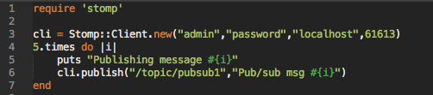
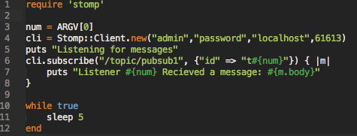
Simple Pub/Sub
Publisher
Subscriber
Files: example1_publisher.rb & example1_subscriber.rb

Slide 46
Event Broadcast
Pub/Sub works great
Good for
Logging
Notifying system components of events as they occur
Monitoring
System diagnostics

Slide 47
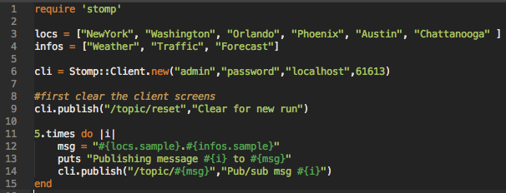
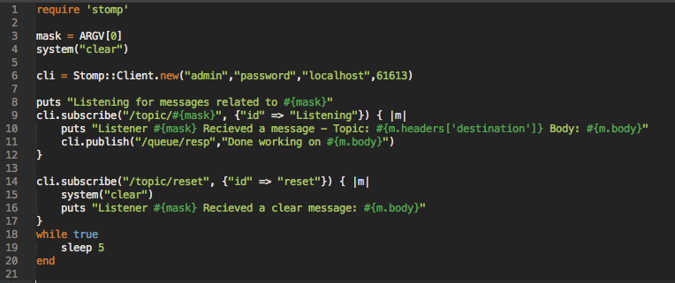
Event Broadcast
Publisher
Listener
Files: example3_publisher.rb, example3_subscriber.rb, example3_subscriber.erl

Slide 48
Work Distribution
Competing consumer works great
Good for
Email sending
Long running job tasking

Slide 49
Work Distribution
Message Exchange
Consumer
Publisher
Queue
Consumer
Consumer
Only one consumer receives a given message
“first come, first served”
Notes:
Flexible – pipelining, binary safe strings
Rearrange in tables

Slide 50
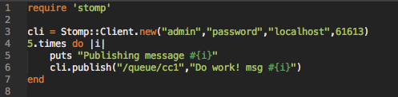
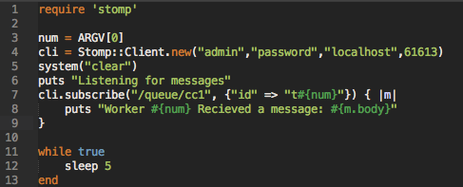
Work Distribution
Publisher
Worker
Files: example2_publisher.rb & example2_consumer.rb

Slide 51
Work Distribution & Consolidation
Adds one more step of complexity
Good for
Distributed workflows
Asynchronous workflows

Slide 52
Work Distribution
Message Exchange
Queue
Message Exchange
Publisher
Consumer
Queue
Consumer
Consumer
Consumer
Notes:
Flexible – pipelining, binary safe strings
Rearrange in tables

Slide 53
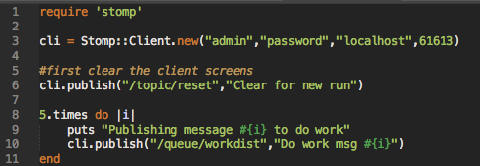
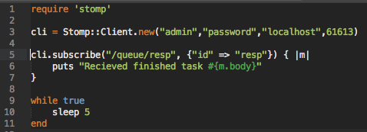
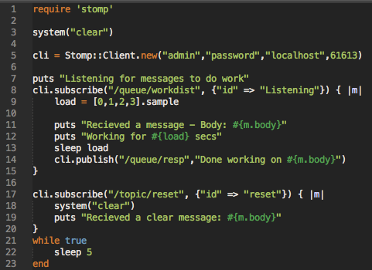
Work Distribution
Final Worker
Publisher
Worker
Files: example4_publisher.rb, example4_worker & example4_final.rb

Slide 54
Questions?

Slide 55
More info
We just scratched the surface
Google
I’d be glad to talk
Chris Meadows
meadoch1@gmail.com
@meadoch1 (Twitter)
https://github.com/meadoch1/PracticalMessaging

